Slide 1

DATA ENGINEERING 1
CHAPTER 4 - DW
Laszlo Sallo
SEPTEMBER 2020

Slide 2


THE IDEAL WORLD OF DATA PERSISTENCY
WHAT WE WISH
REALITY
Read and write depends
on your data volume.
Read and write go against
each other.
Infinite storage
Immediate data write
Immediate data read
Notes:
For many years the main problem was the first one. So we had to select the data carefully

Slide 3
THE COMPROMISE
PERFORMANCE OR VOLUME ?
WRITE OR READ ?

Slide 4
SEPARATION OF DATA LAYERS
Operation1
Operation2
Operation3
Operation4
Operation5
Operational Data Layer
Analytical Data Layer

Slide 5
DATA LAYERS
 | OPERATIONAL | ANALYTICAL
Data age | 60-90 days | 3-10 years
Immutability | Can update / delete | No update / rare delete
Users | Operation and administration | Analysts and Stakeholders
Speed | Performance sensitive | Not performance critical
Optimized for | Many users | Few users
 | Simple queries | Complex queries
 | Real time | Delayed
 | Write optimized | Read optimized

Slide 6
TYPES OF ANALYTICS
Prediction
What might happen ?
Monitoring
What’s happening now ?
Analysis
Why did it happen ?
Reporting
What happened ?
BUSINESS
INTELLIGENCE (BI)

Slide 7
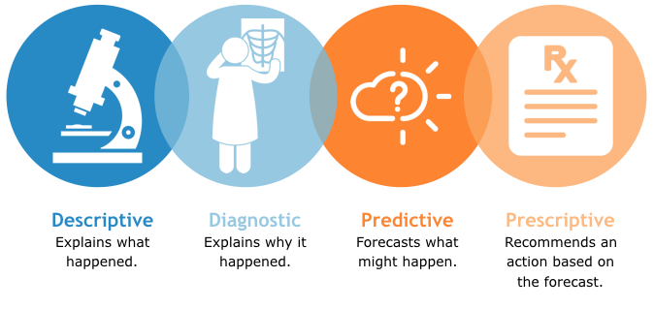
TYPES OF ANALYTICS

Slide 8
BI ARCHITECTURE
OLTP
EDW
Data Delivery
BI Analytics
CRM
Data mart
Advanced
Analytics
HR
ETL
Data
Warehouse
ETL
Data mart
Reports
SCM
Data mart
…
E-com
…
…

Slide 9
BI ARCHITECTURE
OLTP
OLTP
Online Transaction Processing Systems
CRM
HR
SCM
Operational data
Write optimized
Unsuitable for analytics
E-com
…

Slide 10
BI ARCHITECTURE
EDW
EDW
Enterprise Data Warehouse
ETL
Data
Warehouse
Data from OLTP
Historical data
Single source of truth
Read optimized
Relevant data for analytics

Slide 11
SUBJECT ORIENTATION
Production
Product Sales
OLTP
Billing
DW
CRM
Store
Operation / Process Oriented
Subject Oriented

Slide 12
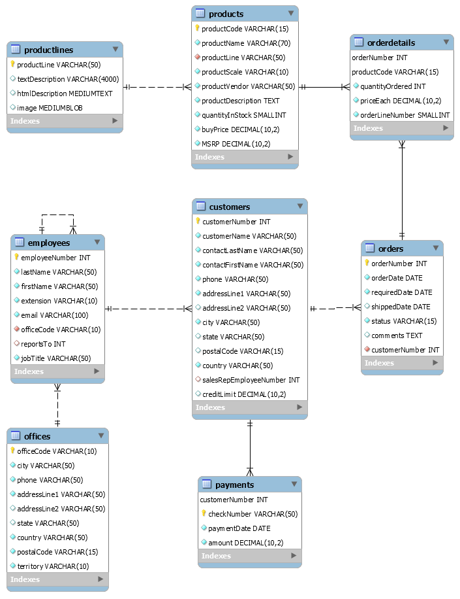
MAPPING TO OUR SAMPLE DB
Production
OLTP
Billing
Store
Operation / Process Oriented

Slide 13
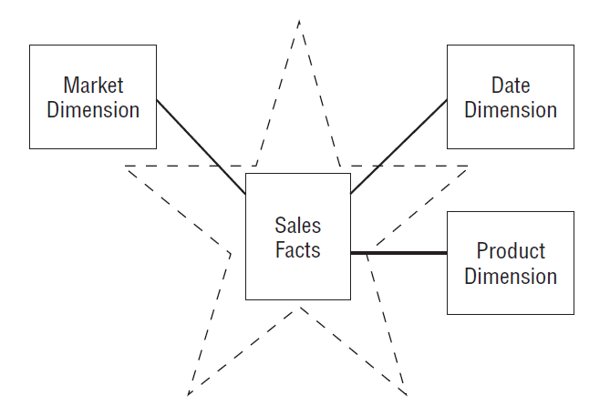
PRODUCT SALES - STAR SCHEMA

Slide 14
PRODUCT SALES
Sales
Fact
Dimension 1:
Product
Dimension 2:
Market
Dimension 3:
Date
Price | Unit | Product | Brand | City | Country | Date | Week of Year
10.000 | 1 | Chair | Ikea | Budapest | HU | 2019.09.20 | 38
500 | 1 | Flower | Zip | London | UK | 2019.09.20 | 38
1.000.000 | 3 | Spaceship | Virgin | Budapest | HU | 2019.09.21 | 38
2.000 | 10 | Weblogic | Oracle | New York | USA | 2019.09.21 | 38

Slide 15
MAPPING TO OUR SAMPLE DB
Sales
Fact
Dimension 1:
Product
Dimension 2:
Market
Dimension 3:
Date
Price | Unit | Product | Brand | City | Country | Date | Week of Year

Slide 16
BI ARCHITECTURE
Data Warehouse
ETL
Extract Transform Load
ETL
Data
Warehouse
Link between OLTP and DW
Data enrichment from external source
Tool or code
Notes:
(Clean, Aggregate)

Slide 17
EXPLOITATION ISSUES
DW = RAW DATA
Still too slow
Different business fields needs different data / aggregation

Slide 18
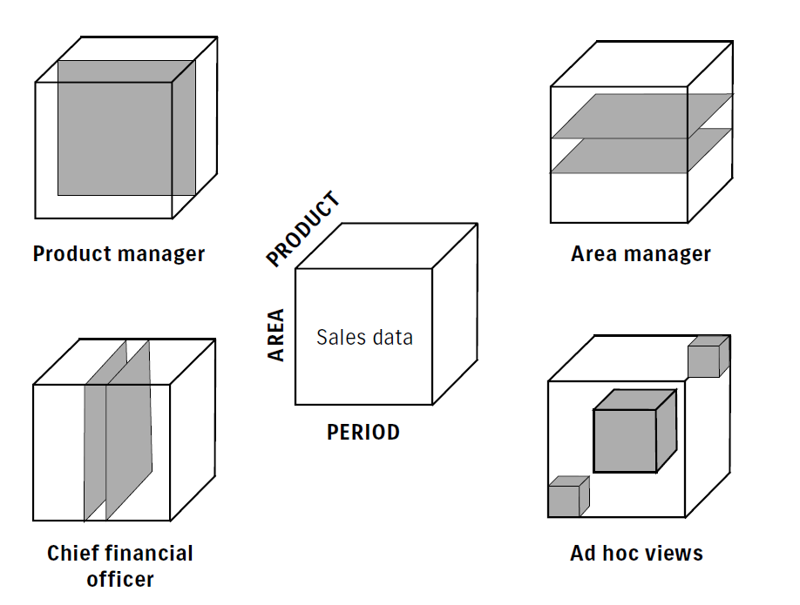
SLICING AND DICING
All Flower sale
All sale of Budapest and New York
Furniture sales of a year in Europe
The current sale vs prev. weeks sales

Slide 19
BI ARCHITECTURE
Data Delivery
DATA
Delivery
Data mart
ETL
Data mart
Analytics driven data marts
Subset Of DW
Slice of a subject
Data mart
…

Slide 20
BI ARCHITECTURE
OLTP
EDW
Data Delivery
BI Analytics
CRM
Data mart
Advanced
Analytics
HR
ETL
Data
Warehouse
ETL
Data mart
Reports
SCM
Data mart
…
E-com
…
…

Slide 21

Reading recommendation
BOOK:
ARTICLE:
Data Warehouse Design – Inmon versus Kimball
http://tdan.com/data-warehouse-design-inmon-versus-kimball/20300

